Slide 1

Spreadsheet Project:
Zomato Restaurants Analysis
Restaurant expansion strategy | Prepared by Priyanshi Pal

Slide 2

Agenda
Problem Statement and Data
Approach and Data Preparation
Objective Metrics and Subjective Insights (Q1 to Q10)
Dashboard and Recommendations

Slide 3
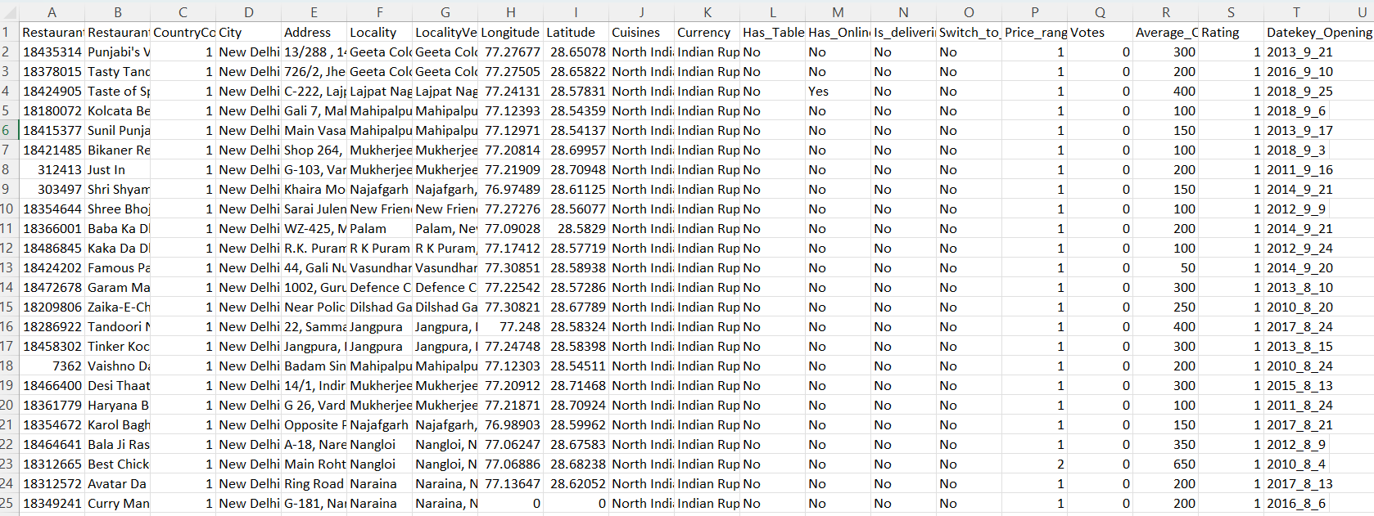
Problem Statement
You are hired as a consultant data analyst by zomato where the team is looking for expansion and opening restaurants. Your task is to come up with strategies/suggestions about opening newer restaurants.

Slide 4
Data Description: 20 attributes for each of the 9,551 restaurants
Restaurant ID: Unique identifier for each restaurant.
Restaurant Name: The name of the restaurant.
CountryCode: Country code of the location where the restaurant is situated.
City: The city where the restaurant is located.
Address: The specific address of the restaurant.
Locality: The locality or neighborhood where the restaurant is situated.
Locality Verbose: Detailed information about the locality.
Longitude: The geographical longitude coordinate of the restaurant.
Latitude: The geographical latitude coordinate of the restaurant.
Cuisines: The type of cuisine offered by the restaurant.
Currency: The currency used for transactions in the restaurant.
Has_Table_booking: Indicates whether the restaurant has a table booking option (Yes/No).
Has_Online_delivery: Indicates whether the restaurant offers online delivery (Yes/No).
Is_delivering_now: Indicates whether the restaurant is currently delivering (Yes/No).
Switch_to_order_menu: Indicates whether users can switch to the order menu (Yes/No).
Price_range: A numeric value indicating the price range category of the restaurant.
Votes: The number of votes or ratings/(feedback) received by the restaurant.
Average_Cost_for_two: The average cost for two people dining at the restaurant.
Rating: The overall rating of the restaurant is based on user reviews.
Datekey_opening: The date when the restaurant was opened.

Slide 5
Our Approach at a Glance
Five steps from raw data to a recommendation
1
2
3
4
5
Prepare
Measure
Score
Test
Recommend
Clean and check the data; add country, year and currency fields
Count restaurants, ratings, votes, prices and services by country and city
One Opportunity Score: 40% low competition, 30% rating, 30% votes
Check cuisine, price, table booking and delivery against ratings
Shortlist countries and cities; show it all on a dashboard
Source: Zomato restaurant dataset, 9,551 restaurants in 15 countries

Slide 6
Data Preparation (Objective Q1 to Q5, Q12)
Is the data complete, consistent and ready to analyse?
Structure: 2 tables (restaurants + country lookup), 20 attributes: 13 categorical, 5 numeric, 1 ID, 1 date.
Checks: 0 duplicate restaurants; 9 blank Cuisines (all USA), left blank.
Dates: Datekey_Opening was text (2013_9_21); split into year, month and day.
Country: Country Name added with XLOOKUP on CountryCode; all 9,551 rows matched.
Price label: Currency symbol + cost built with MID and FIND, e.g. 'Rs. 300'.
Flagged, not deleted: 2,148 ratings of exactly 1.0 (placeholder), 18 zero costs, mislabelled Philippines currency.
9,551
20
restaurants
attributes
15
0
countries
duplicates
Source: sheets 'Raw Data', 'Cleaned Data', 'country description'

Slide 7
Objective Q6 to Q13: Method and Result
Question | Method | Result
Q6 Restaurants per country | Pivot table, COUNTA | India 8,652 ... Canada 4 (total 9,551)
Q7 Restaurants opened per year | Pivot by year + line chart | About 1,000 to 1,100 a year; 1,102 in 2018
Q8 India, price range 4 | COUNTIFS | 388 restaurants
Q9 Average votes per country | Pivot table, AVERAGE | Indonesia 772 highest; Brazil 20 lowest
Q10 Avg rating, price < 4 and delivery | IF + SUM array formula | 3.27 (2,398 restaurants)
Q11 Highlight suggested markets | Conditional formatting, custom formula | 77 country rows; 50 city rows
Q12 Cost with currency symbol | MID + FIND text functions | e.g. Rs. 300, $ 50, AED 100
Q13 No delivery, range 1, cost <= 250 | Array formula (SUM + IF) | 1,834 restaurants
Source: sheets 'Q-6' to 'Q-13 I Objective'

Slide 8
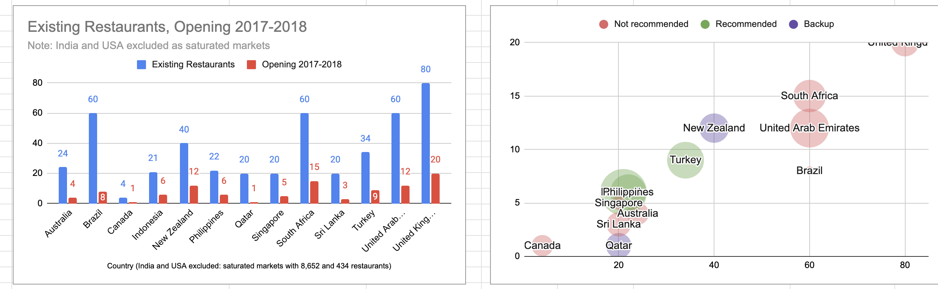
Q1: Which Countries Offer Room to Grow?
Fewer competitors, but customers who already love eating out
Compare: competition (existing restaurants), demand (average votes) and quality (average rating).
Exclude: India (8,652) and USA (434) from scoring; they are too big and would distort the scale.
Score: Opportunity = 40% low competition + 30% rating + 30% votes, each scaled 0 to 1.
Rank: 1 to 3 = Recommended, 4 to 5 = Backup.
Visual: bubble chart: competition vs rating, bubble size = votes.
Insert chart / table here
Q-1 bubble chart + score table (sheet 'Q-1 I Subjective')
RECOMMENDED
Indonesia 0.85 | Philippines 0.76 | Turkey 0.65. Backups: Qatar, New Zealand.
Source: sheet 'Q-1 I Subjective'

Slide 9
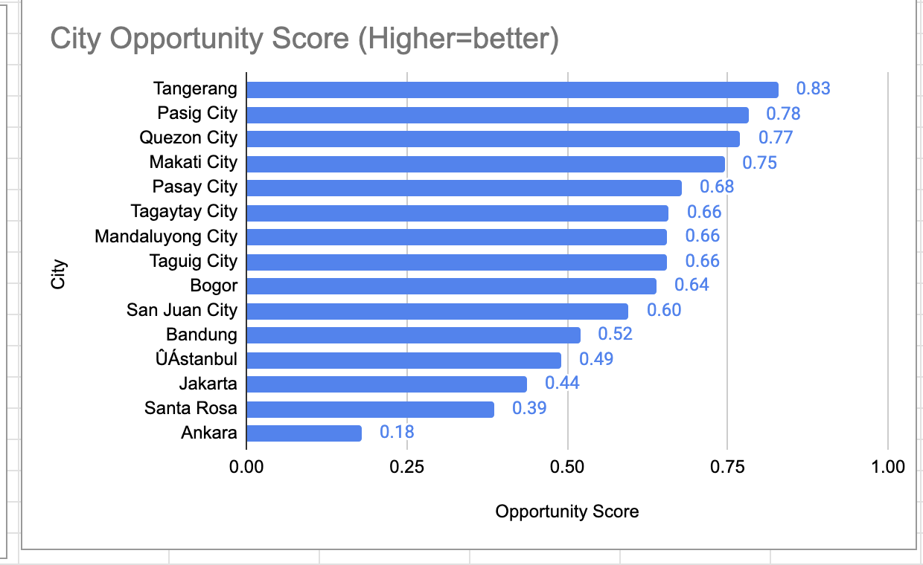
Q2: Which Cities Within Those Countries?
The data has no State column, so we work at city level
Table: restaurants, average rating and average votes for the 15 cities in the three countries.
Score: same Opportunity Score as Q1, scaled across these cities.
Evidence rule: a city with only 1 restaurant is 'Watchlist', not recommended.
Tiers: High potential (score 0.6+), Proven market (500+ votes, 4.2+ rating), Low priority.
Visual: bubble map of competition vs quality + ranked score bars.
Insert chart / table here
City bubble map + score bars (sheet 'Q-2 I Subjective')
SUGGESTED CITIES
Indonesia: Tangerang, Jakarta, Bogor. Philippines: Pasig, Makati, Pasay, Mandaluyong, Taguig. Turkey: Istanbul.
Source: sheet 'Q-2 I Subjective'

Slide 10
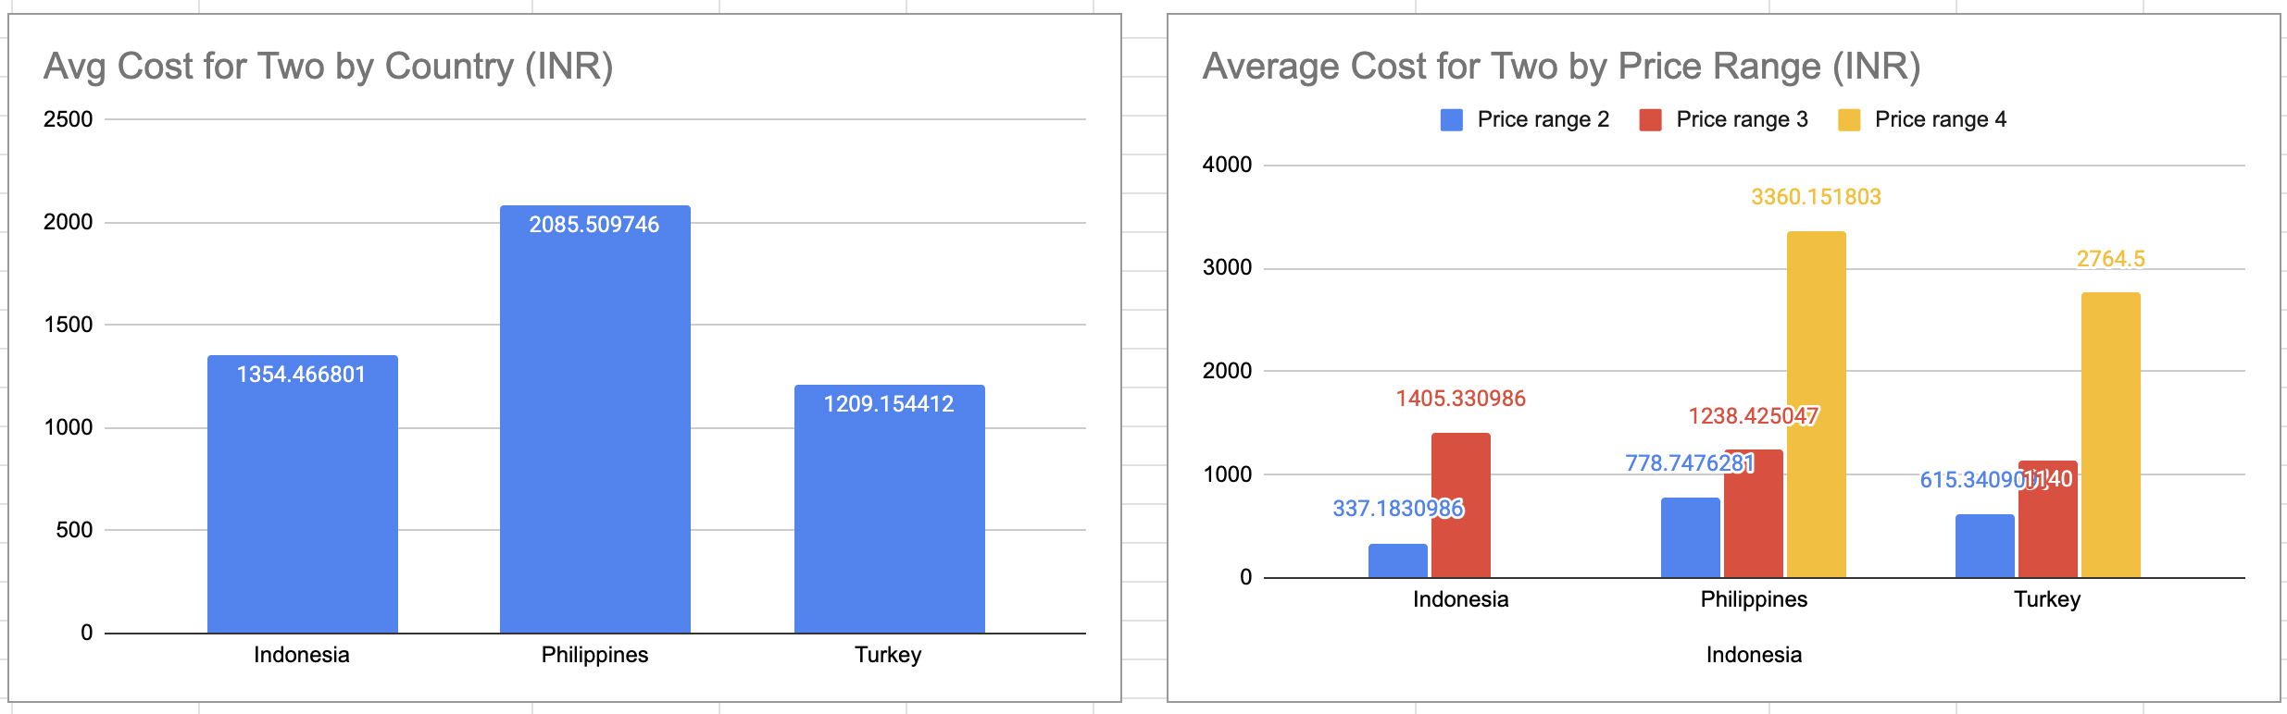
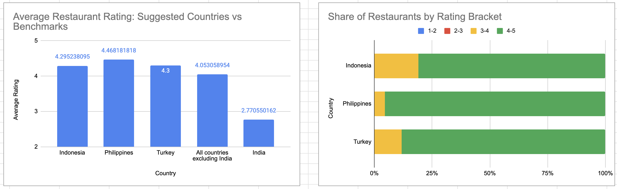
Q3 and Q4: Rating Quality and Food Expenditure
Q3 Current quality of ratings
Q4 Current food expenditure
Measure: average and median rating per suggested country.
Brackets: share of restaurants rated 1-2, 2-3, 3-4, 4-5.
Benchmarks: all other countries (excl. India) and India.
Convert: average cost for two to INR with assumed 2018 rates (editable cells).
Compare: by country and by price range (2, 3, 4) for like-for-like.
Note: Philippines currency was mislabelled; treated as peso.
Insert chart / table here
Q3 charts (sheet 'Q-3 I Subjective')
Insert chart / table here
Q4 charts (sheet 'Q-4 I Subjective')
FINDING
Philippines 4.47, Indonesia 4.30, Turkey 4.30. None below 3.4, so aim for 4.3+.
FINDING
Turkey ~INR 1,210 < Indonesia ~1,350 < Philippines ~2,090 for a meal for two.
Source: sheets 'Q-3 I Subjective' and 'Q-4 I Subjective'. Exchange rates are approximate assumptions

Slide 11
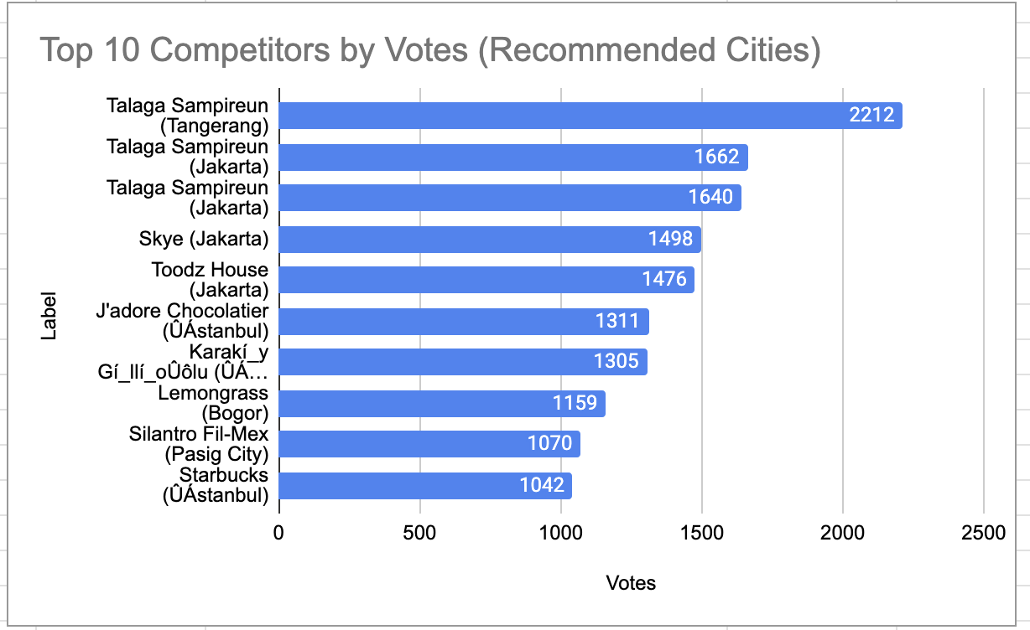
Q5: Biggest and Weakest Competitors
Who do we have to beat, and who is easiest to beat?
Where: the nine recommended cities from Q2.
Biggest competitors: restaurants with the most votes (customer reach), rating as tie-break.
Lower brackets: restaurants rated 1-2 or 2-3 (none), then the weakest below 4.
Method: FILTER + SORT on the cleaned data.
Insert chart / table here
Top 10 competitors chart + lists (sheet 'Q-5 I Subjective')
FINDING
Biggest threat: Talaga Sampireun (4.9, 3 branches). Weakest: Fish Streat 3.4, Onokabe, Huqqa.
Source: sheet 'Q-5 I Subjective'

Slide 12
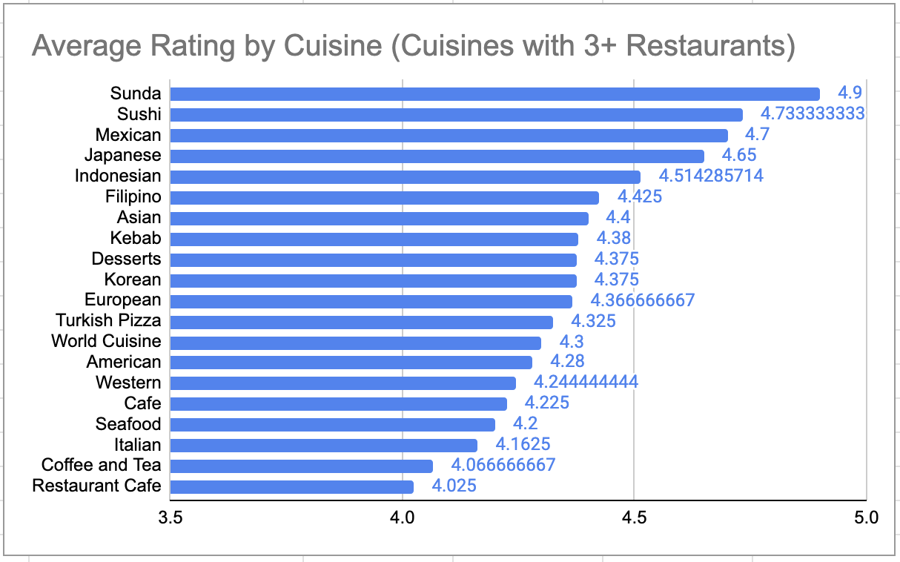
Q6: Which Cuisines Should We Focus On?
Does the choice of cuisine change ratings?
Count: a restaurant counts once for every cuisine it serves (cuisines are comma-separated).
Scope: 77 restaurants in the three countries, 39 cuisines.
Measure: restaurants, average rating and average votes per cuisine.
Reliability: chart cuisines with 3+ restaurants; best/worst lists use 8+.
Cuisine effect: gap between best and worst cuisine.
Insert chart / table here
Cuisine rating chart (sheet 'Q-6 I Subjective')
FINDING
Focus: Japanese 4.65, Indonesian 4.51, Filipino 4.42, Desserts 4.38. Cafe and Italian are crowded. Effect: moderate (0.49).
Source: sheet 'Q-6 I Subjective'

Slide 13
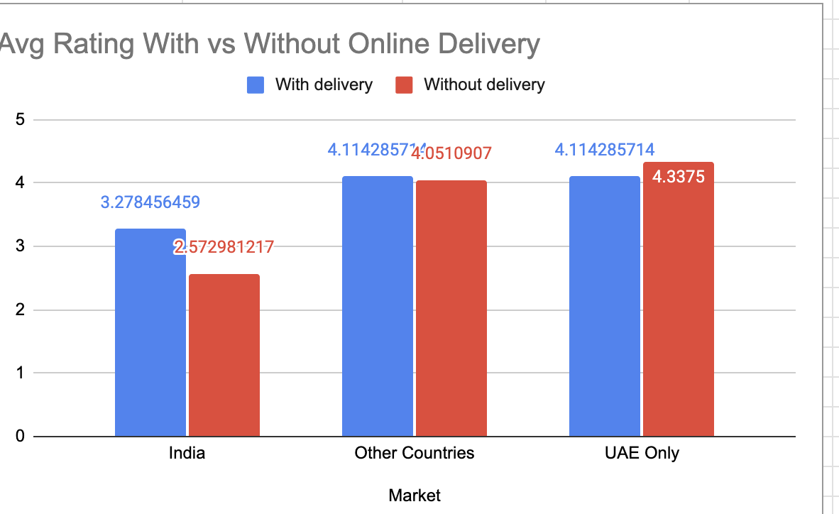
Q7: Online Delivery and Table Booking
Should we offer them, and do they change ratings?
Compare: average rating with vs without each service.
Split: suggested countries, India and other countries (India's ratings are much lower overall).
Control: repeat inside price ranges 2 to 4, so higher prices do not explain the gap.
Check: how many restaurants in the suggested countries offer each service.
Insert chart / table here
With vs without charts (sheet 'Q-7 I Subjective')
FINDING
Table booking: yes (4.43 vs 4.03 outside India). Delivery: not a launch priority; no data yet in these countries.
Source: sheet 'Q-7 I Subjective'

Slide 14
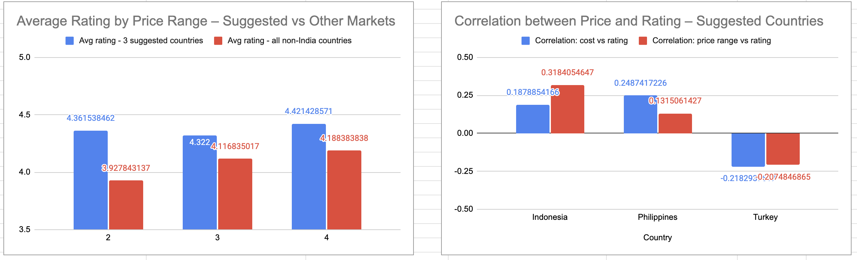
Q8: Does a Higher Price Mean Better Ratings?
Should the team price cuisines higher?
Reading: 'rate of cuisines' = average cost for two.
Test: correlation (CORREL) of cost and rating in each country; price range pooled across currencies.
Benchmarks: other countries and India.
Rule of thumb: between -0.2 and +0.2 means almost no relationship.
Insert chart / table here
Correlation chart + price-range chart (sheet 'Q-8 I Subjective')
FINDING
Weak and inconsistent: +0.19, +0.25, -0.22; pooled +0.05. No need to price higher.
Source: sheet 'Q-8 I Subjective'

Slide 15
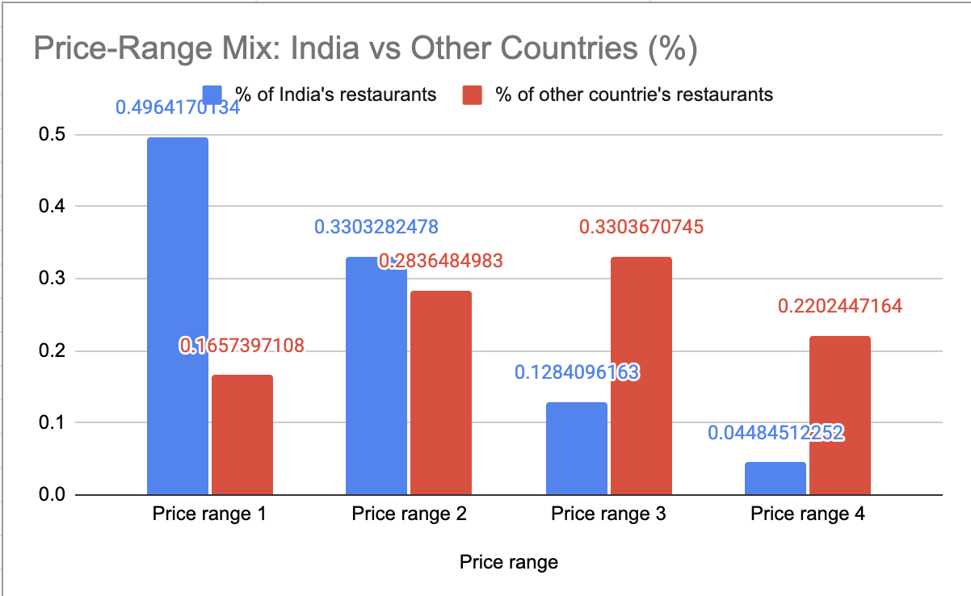
Q9: Price Range Mix Across Countries
How are restaurants spread across price ranges 1 to 4?
Count: restaurants by country and price range (COUNTIFS).
Percent: each country's mix in % so large and small markets compare fairly.
Visuals: 100% stacked bar by country, and India vs all other countries.
Link: tie the mix back to our recommended markets.
Insert chart / table here
Price-range mix charts (sheet 'Q-9 I Subjective')
FINDING
India: 83% in ranges 1-2. Others: 55% in ranges 3-4. Indonesia: 95% in range 3. Go mid-range.
Source: sheet 'Q-9 I Subjective'

Slide 16
Q10: Our Approach Without Pre-Set Questions
How we would pick countries and cities from scratch
1
Define the goal
high demand, happy customers, manageable competition, affordable costs
5
Check price fit
cost and price-range mix in a common currency
2
Clean the data
remove duplicates and blanks, fix formats, one currency
6
Map competition
strongest and weakest restaurants per shortlisted city
3
Size up markets
restaurants per country and city: crowded or open?
7
Pick cuisine and services
which cuisines and services lift ratings
4
Check satisfaction
ratings and votes: proven market or weak competitors?
8
Score, rank, pilot
weighted score with a minimum sample, then a small pilot
Same logic as Q1 to Q9, applied step by step

Slide 17
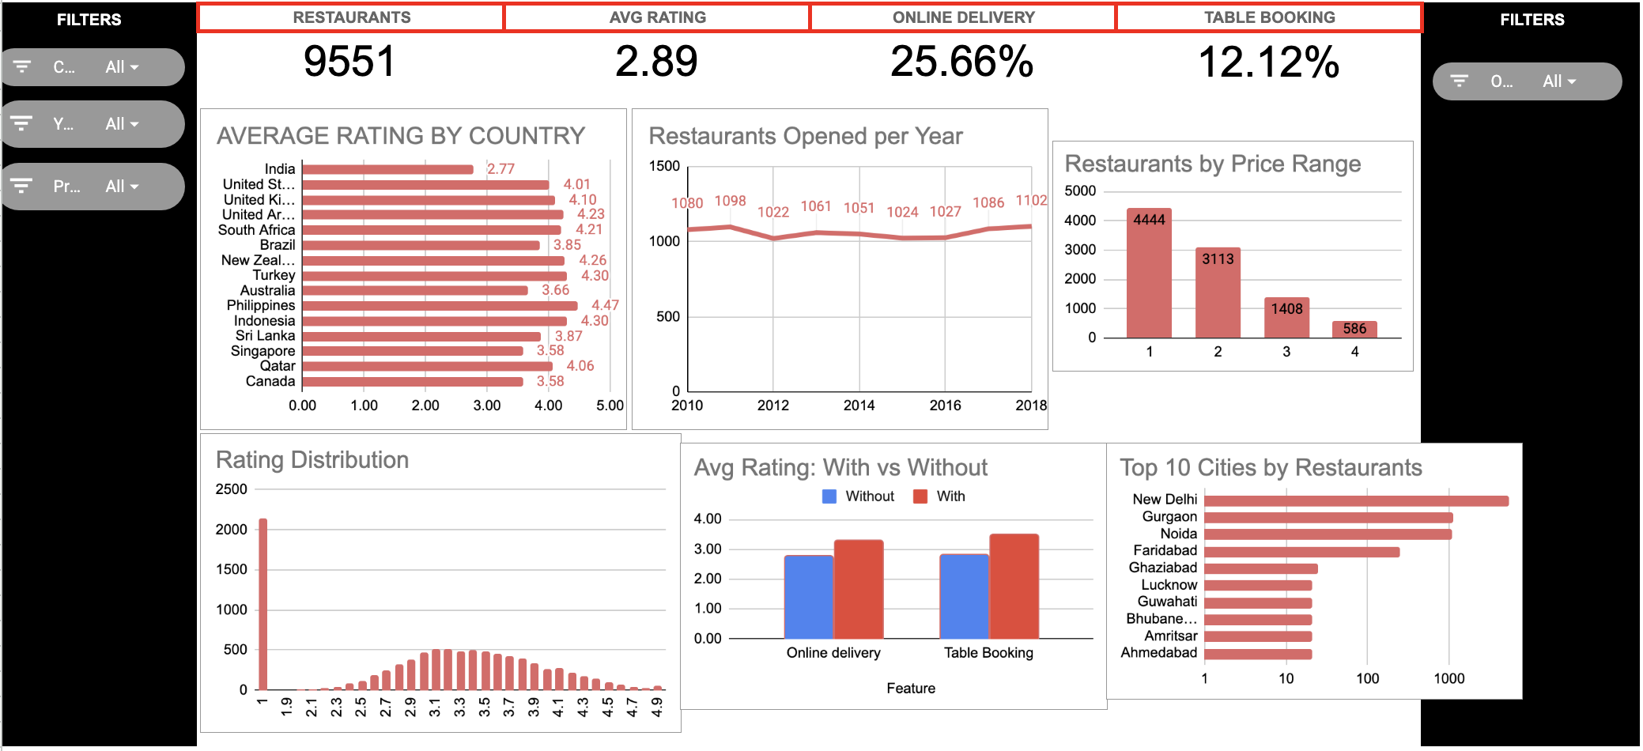
Interactive Dashboard
One page for management, filtered by country and year
Cards: restaurants, average rating, online delivery %, table booking %.
Charts: rating by country, openings per year, price range, rating spread, services vs rating, top cities.
Slicers: Country, Year, Price range and Online delivery on the left and right.
How it works: pivot tables on the cleaned data feed every card and chart, so one click updates the whole page.
Insert chart / table here
Dashboard screenshot (sheet 'Dashboard')
Source: sheet 'Dashboard'

Slide 18
Recommendations
What we suggest to management
WHERE
Indonesia, the Philippines and Turkey. Backups: Qatar and New Zealand.
WHICH CITIES
Tangerang, Jakarta, Bogor | Pasig, Makati, Pasay, Mandaluyong, Taguig | Istanbul
WHAT TO SERVE
Japanese/Sushi, local cuisine (Indonesian, Filipino), Desserts.
SERVICES
Launch with dine-in plus table booking; trial delivery later.
PRICING
Mid-range (price range 2 to 3). Higher prices do not buy better ratings.
QUALITY BAR
Existing restaurants average 4.3 to 4.5, so aim for 4.3+.
Based on Q1 to Q9 findings

Slide 19
Data Notes and Next Steps
What to keep in mind when using these results
Small samples: the three countries hold only 77 restaurants, so scores are directional.
Placeholder ratings: 2,148 restaurants have a rating of exactly 1.0 (1,094 with no votes), mostly in India; none in the suggested countries.
Association, not cause: table booking and price findings show links, not proof.
Assumptions: exchange rates are approximate 2018 averages; Philippines currency was mislabelled in the data.
No State column: recommendations are at country and city level.
Next: re-run the scoring as new data arrives and pilot in the top cities before a full roll-out.

